Slide 1

Automotive Technology:
A Systems Approach, 8e
Chapter 5: Hand Tools and Shop Equipment
Rob Thompson and Jack Erjavec, Automotive Technology: A Systems Approach, 8th Edition. © 2025 Cengage. All Rights Reserved. May not be scanned, copied or duplicated, or posted to a publicly accessible website, in whole or in part.

Slide 2
Chapter Objectives (1 of 2)
05.01 List the basic units of measure and apply them to the two measuring systems.
05.02 Describe the different types of fasteners used in the automotive industry.
05.03 List the various mechanical measuring tools used in the automotive shop.
05.04 List some of the common hand tools used in auto repair.

Slide 3
Chapter Objectives (2 of 2)
05.05 List the common types of shop equipment and state their purpose.
05.06 Describe the use of common pneumatic, electrical, and hydraulic power tools.
05.07 Describe the types and safe use of jacks and lifts.
05.08 Describe the different sources of service information that are available to technicians.

Slide 4
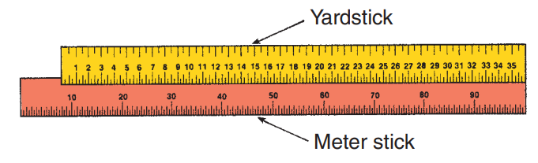
Measuring Systems
05-01 List the basic units of measure and apply them to the two measuring systems.
Two systems of weights and measures exist side-by-side in the United States—the Imperial or U.S. customary (US) system and the international or metric system.
The basic unit of linear measurement in the U.S. system is the inch.
The basic unit of linear measurement in the metric system is the meter.

Slide 5
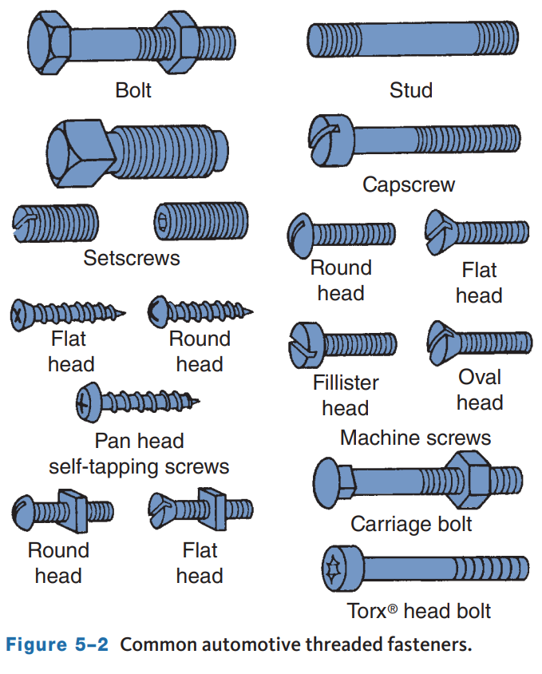
Fasteners (1 of 4)
05.02 Describe the different types of fasteners used in the automotive industry.
Fasteners are used to secure or hold different parts together or to mount a component.
Many types and sizes of fasteners are used.
  Each is designed for a specific purpose.
  The most common is the threaded fastener which includes bolts, nuts, and screws.

Slide 6
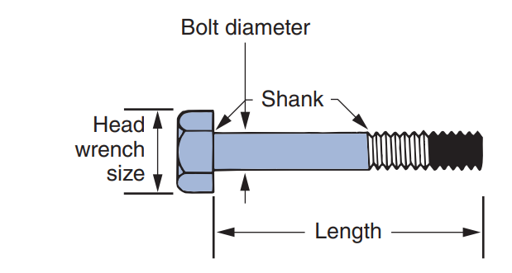
Fasteners (2 of 4)
Bolts
  Bolts have a head on one end and threads on the other.
  They are identified by their head size, shank (shoulder) diameter, thread pitch, length, and grade.
  The bolt head is used to loosen and tighten the bolt.
  Bolt diameter is the measurement across the diameter of the threaded area or bolt shank.

Slide 7
Fasteners (3 of 4)
Bolts
  The thread pitch of a bolt in the U.S. system is the number of threads that are in 1 inch of the threaded length and is expressed in number of threads per inch.
  A UNF bolt with a 3/8-inch diameter is marked as a 3/8 × 24 bolt. It has 24 threads per inch.
  The distance, in millimeters, between two adjacent threads determines the thread pitch in the metric system.
  This distance will vary between 1.0 and 2.0 and depends on the diameter of the bolt.
  The lower the number, the closer the threads are placed and the finer the threads are.
  The bolt’s tensile strength, or grade, is the amount of stress or stretch it is able to withstand before it breaks.

Slide 8
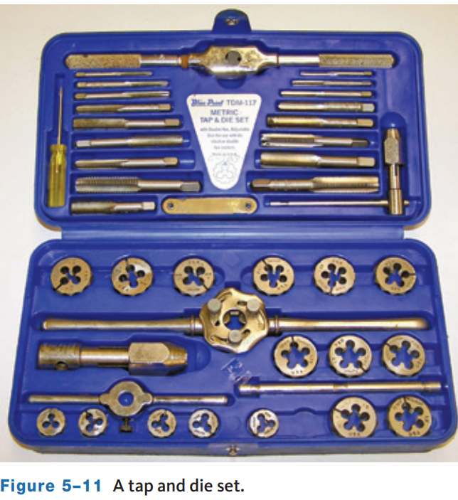
Fasteners (4 of 4)
Taps and Dies
  The hand tap is a small tool used for hand cutting internal threads.
  Hand-threading dies are the opposite of taps because they cut external (outside) threads on bolts, rods, and pipes rather than internal threads.
  Dies are made in various sizes and shapes.

Slide 9
Washers and Other Common Fasteners
Flat washers
  Are used with a fastener to spread out the load.
Lock washers
  Are used to lock the bolt head or nut in place.
Nuts
  Are used with bolts and studs and have different designs.
Cap screws
  Are similar to bolts but do not have a shoulder.
Setscrews
  Are used to prevent rotary motion between two parts.

Slide 10
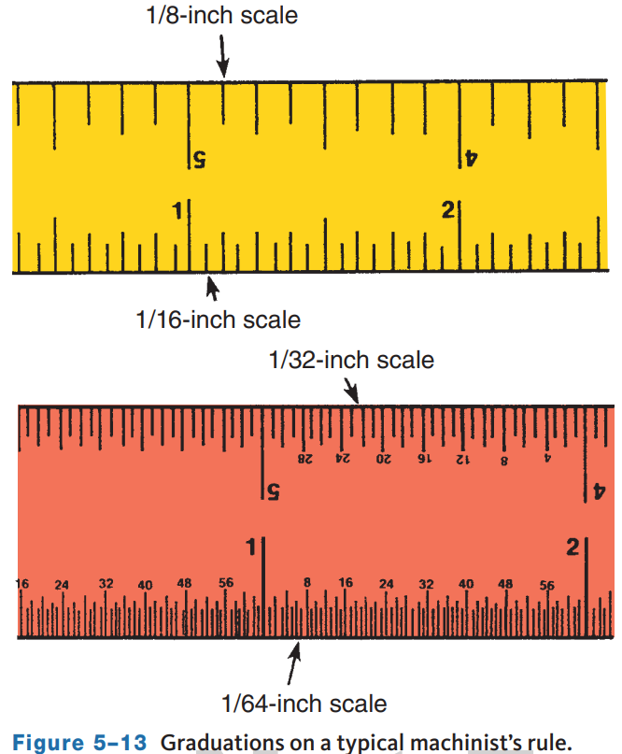
Measuring Tools (1 of 6)
05.03 List the various mechanical measuring tools used in the automotive shop.
Machinist’s Rule
  It looks a lot like an ordinary ruler.
  Each edge is divided into increments based on a different scale.
  It is based on the U.S. system of measurement and may have scales based on 1⁄8-, 1⁄16-, 1⁄32-, and 1⁄64-inch intervals.

Slide 11
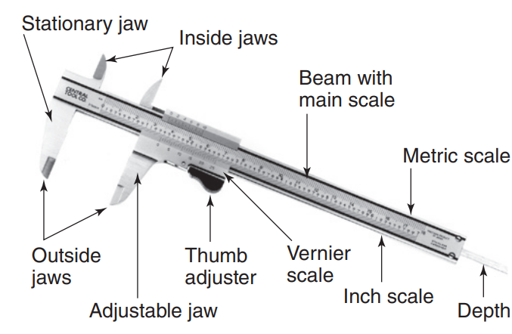
Measuring Tools (2 of 6)
Vernier Caliper
  It is a measuring tool that can make inside, outside, or depth measurements.
  It is marked in both U.S. and metric divisions called a vernier scale.
    Consists of a stationary scale.
  It has a movable scale that is parallel to a fixed scale.

Slide 12
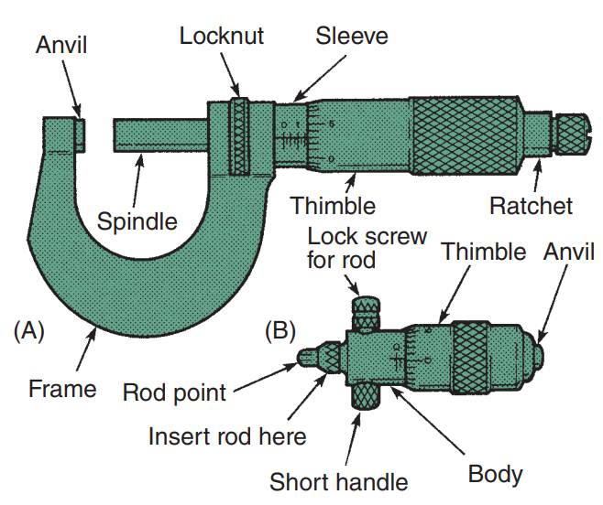
Measuring Tools (3 of 6)
Micrometers
  They are used to measure linear outside and inside dimensions.
  Outside and inside micrometers are calibrated and read the same.
  They are designed to measure objects with accuracy to 0.001 (one-thousandth) inch.

Slide 13
Measuring Tools (4 of 6)
Reading an outside micrometer includes the following:
  As with the inch-graduated micrometer, the three separate readings are added together to obtain the total reading.
  To measure small objects with an outside micrometer, open the tool and slip the object between the spindle and anvil.
  While holding the object against the anvil, turn the thimble with your thumb and forefinger until the spindle contacts the object.
  Use only enough pressure on the thimble to allow the object to just fit between the anvil and spindle.
  Slip the micrometer back and forth over the object until you feel a very light resistance, while at the same time rocking the tool from side to side to make certain the spindle cannot be closed any further.

Slide 14
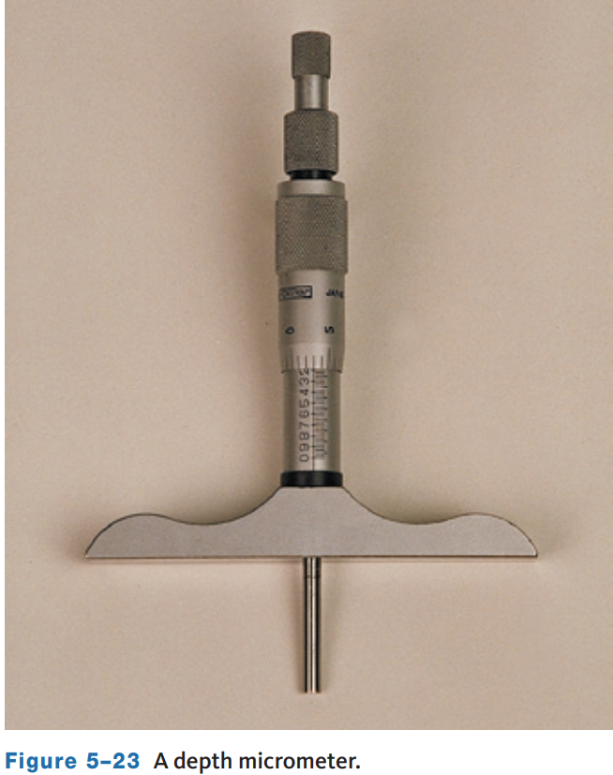
Measuring Tools (5 of 6)
Inside Micrometer
  They are used to measure the inside diameter of a bore or hole.
Depth Micrometer
  They are used to measure the distance between two parallel surfaces.
  It operates and is read in the same way as other micrometers.

Slide 15
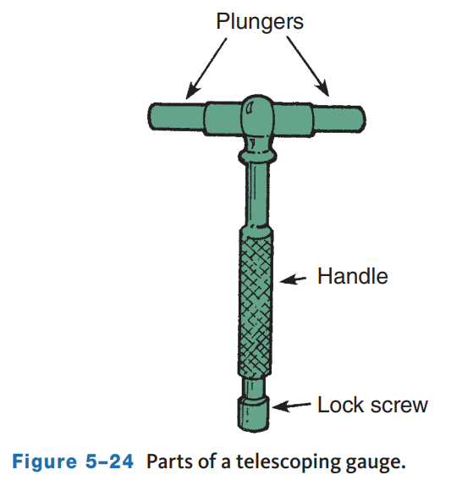
Measuring Tools (6 of 6)
Telescoping Gauge and Small Hole Gauge
  Telescope gauges are used for measuring bore diameters and other clearances.
  Are available in sizes ranging from fractions of an inch through 6 inches (150 mm).
  A small hole or ball gauge works just like a telescoping gauge but is designed to be used on small bores.

Slide 16
Knowledge Check (1 of 3)
Like many of the tools listed in this chapter, a micrometer is a precision measurement tool. How much pressure should be applied when measuring a part?

Slide 17
Knowledge Check Answer (1 of 3)
Like many of the tools listed in this chapter, a micrometer is a precision measurement tool. How much pressure should be applied when measuring a part?
  Answer: Use only enough pressure on the thimble to allow the object to just fit between the anvil and spindle. Slip the micrometer back and forth over the object until you feel a very light resistance, while at the same time rocking the tool from side to side to make certain the spindle cannot be closed any further.

Slide 18
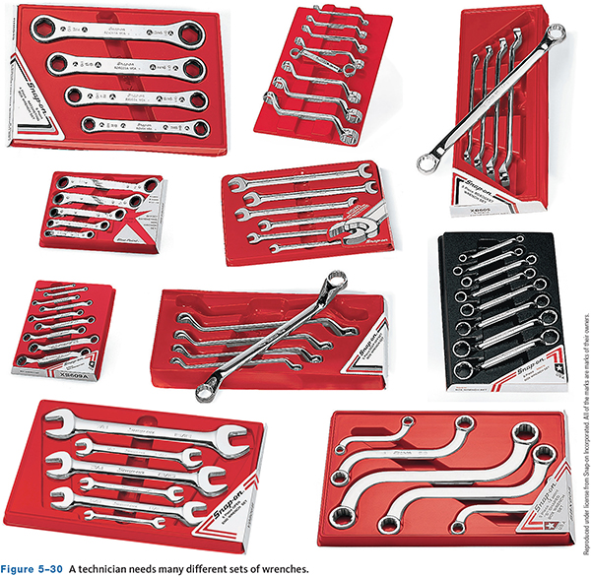
Hand Tools
05.04 List some of the common hand tools used in auto repair.
Wrenches
  It is a tool for twisting and/or holding bolt heads or nuts.
  The jaw of a wrench fits around all sides of bolt heads and nuts to turn the bolt or nut.
  All technicians should have a collection of wrenches in a variety of sizes and styles in both metric and U.S. wrenches.

Slide 19
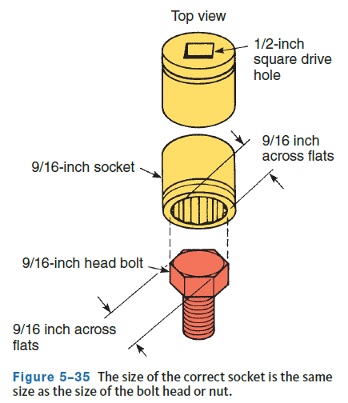
Sockets and Ratchets
The ratchet allows you to turn the socket in one direction with force and in the other direction without force, which allows you to tighten or loosen a bolt without removing and resetting the wrench after you have turned it.
They come in ¼ inch, 3⁄8 inch, ½ inch, and so on which indicates the drive size of the socket wrench.
The inside of the socket fits the fastener head like the 9/16 shown.

Slide 20
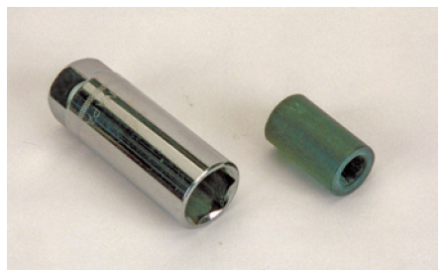
Sockets
Deepwell sockets are made extra long to fit over bolt ends or studs.
A spark plug socket is an example of a special purpose deep-well socket.
Heavier-walled sockets are designed for use with an impact wrench and are called impact sockets. Most sockets are chrome-plated, except for impact sockets, which are not.

Slide 21
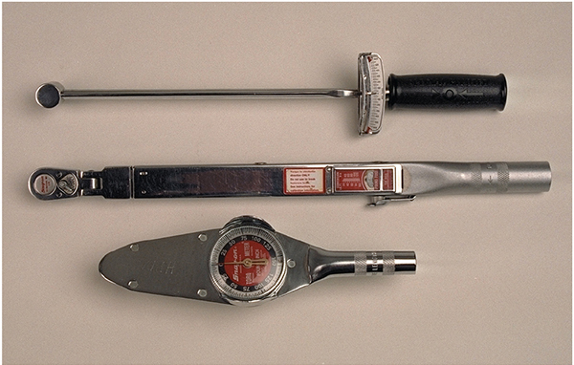
Torque Wrenches
Torque wrenches measure how tight a nut or bolt is.
Nearly all of a car’s nuts and bolts should be tightened to a certain amount and have a torque specification that is expressed in footpounds (U.S.), Newton-meters (metric), or a combination of foot-pounds or Newton-meters plus an angle.

Slide 22
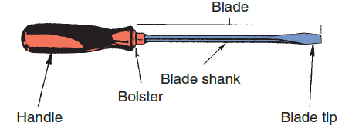
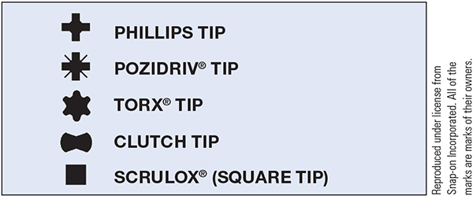
Screwdrivers
A screwdriver drives a variety of threaded fasteners used in the automotive industry.
Each fastener requires a specific kind of screwdriver.
Screwdrivers are defined by their sizes, their tips, and the types of fasteners they should be used with.
Your tool set should have blade and Phillips drivers in a variety of lengths.

Slide 23
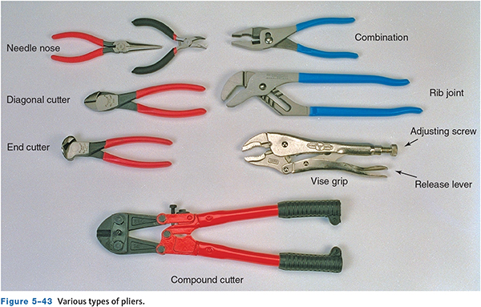
Pliers
Pliers are gripping tools used for working with wires, clips, and pins.
At a minimum, an auto technician should own several types: standard pliers for common parts and wires, needle nose for small parts, and large, adjustable pliers for large items and heavy-duty work.

Slide 24
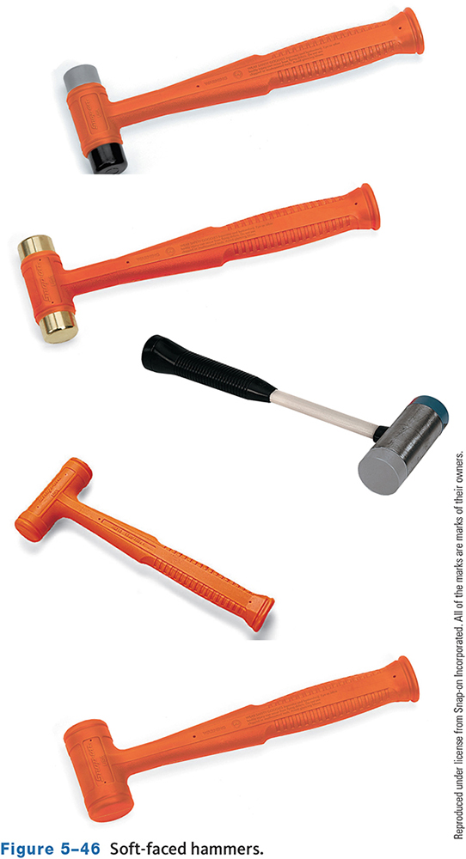
Hammers
Hammers are identified by the material and weight of the head. There are two groups of hammer heads: steel and soft faced.
  Your tool set should include at least three hammers: two ball-peen hammers, one 8-ounce and one 12- to 16-ounce hammer, and a small sledgehammer or dead blow hammer.
  A dead blow hammer contains lead shot to reduce rebound and can be either steel or rubber faced.
  Softfaced hammers should be used on machined surfaces to not mar the finish.

Slide 25
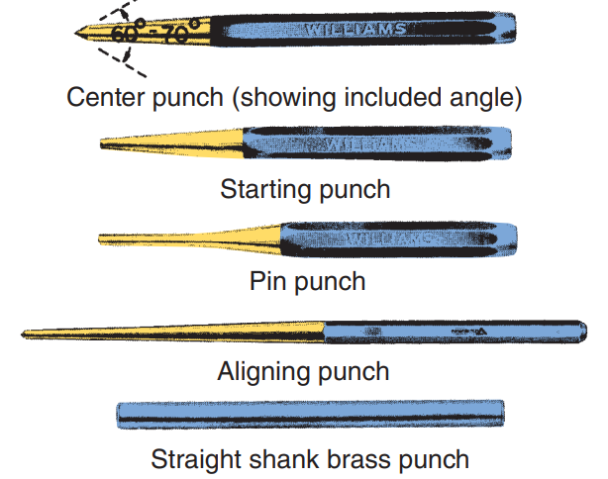
Chisels and Punches
Chisels are used to cut metal by driving them with a hammer.
  A variety of chisels are available, each with a specific purpose, including flat, cape, round-nose cape, and diamond point chisels.
Punches are used for driving out pins, rivets, or shafts; aligning holes in parts during assembly; and marking the starting point for drilling a hole.

Slide 26
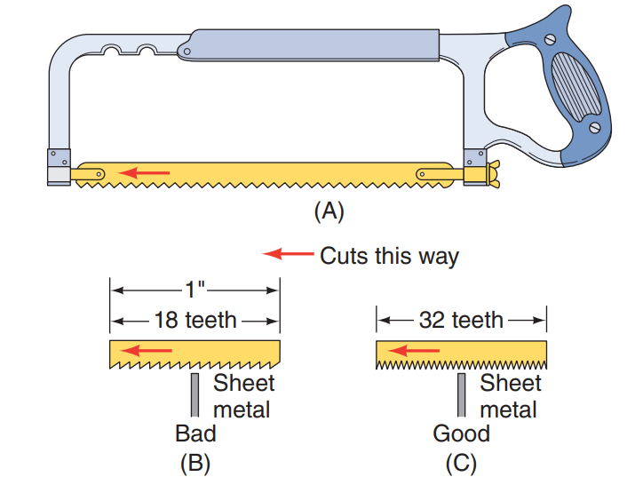
Hacksaws
They are used to cut metal.
The blade only cuts on the forward stroke.
The teeth of the blade should always face away from the saw’s handle.
The number of teeth on the blade determines the type of metal the saw can be used on.

Slide 27
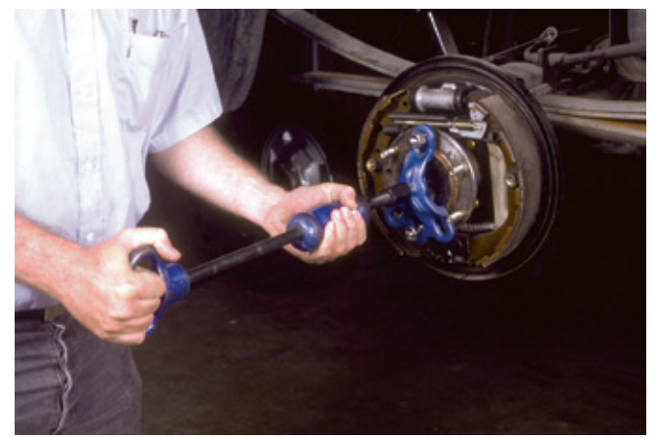
Gear and Bearing Pullers
Many precision gears and bearings have a slight interference fit (press fit) when installed on a shaft or housing. For example, the inside diameter of a bore is 0.001 inch smaller than the outside diameter of a shaft.
When the shaft is fitted into the bore, it must be pressed in to overcome the 0.001-inch interference fit this press fit prevents the parts from moving on each other.
The removal of gears and bearings must be done carefully. Prying or hammering can break or bind the parts.

Slide 28
Knowledge Check (2 of 3)
  True or False? Punches are gripping tools used for working with wires, clips, and pins

Slide 29
Knowledge Check Answer (2 of 3)
  True or False? Punches are gripping tools used for working with wires, clips, and pins
  Answer: False. Pliers are gripping tools used for working with wires, clips, and pins
  Punches are used for driving out pins, rivets, or shafts; aligning holes in parts during assembly; and marking the starting point for drilling a hole

Slide 30
Shop Equipment
05.05 List the common types of shop equipment and state their purpose.
Bench Grinder
  This electric power tool is generally bolted to a workbench.
  The grinder should have safety shields and guards.
  A bench grinder is classified by wheel size.
    Three types of wheels are available with this bench tool:
      Grinding wheel, for a wide variety of grinding jobs from sharpening cutting tools to deburring.
      Wire wheel brush, for general cleaning and buffing, removing rust, scale, and paint, deburring, and so forth.
      Buffing wheel, for general purpose buffing, polishing, and light cutting.

Slide 31
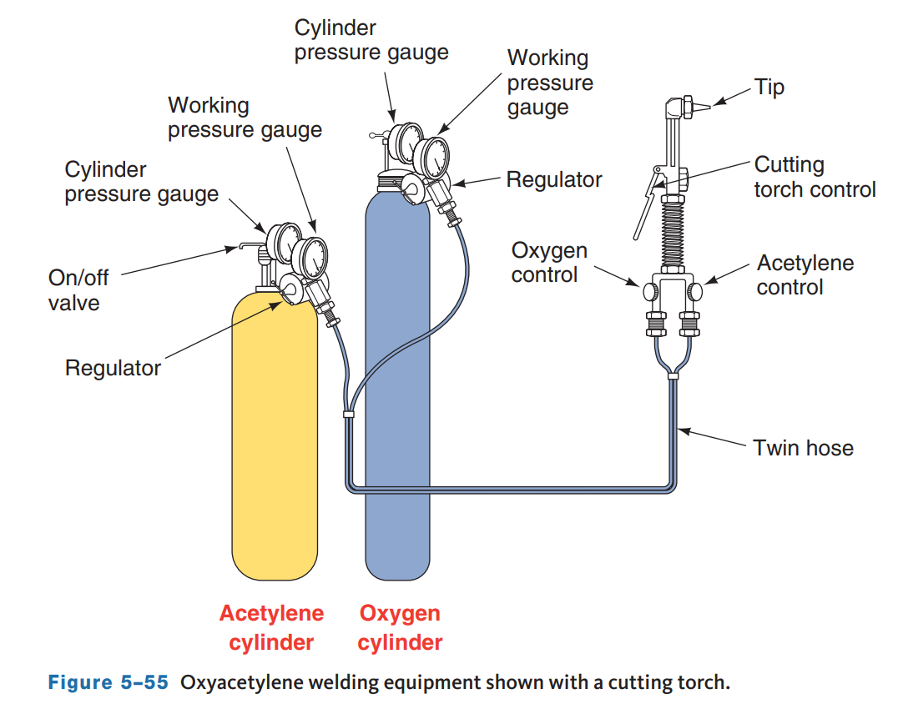
Oxyacetylene Torches
They have many purposes including being used to heat metal when two parts are difficult to separate, to cut metal (such as when replacing exhaust system parts), and to weld or connect two metal parts together
Oxyacetylene welding and cutting equipment uses the combustion of acetylene in oxygen to produce a flame temperature of about 5,600 °F

Slide 32
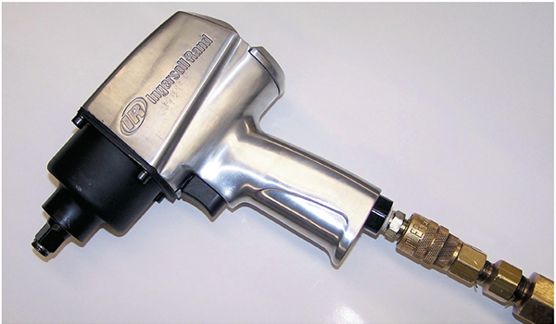
Power Tools
05.06 Describe the use of common pneumatic, electrical, and hydraulic power tools.
Impact Wrench
  When triggered, the output shaft, onto which the impact socket is fastened, spins freely at 2,000 to 14,000 rpm, depending on the wrench’s make and model.
  When the impact wrench meets resistance, a small spring-loaded hammer strikes an anvil attached to the drive shaft onto which the socket is mounted. Each impact moves the socket around a little until torque equilibrium is reached, the fastener breaks or the trigger is released.

Slide 33
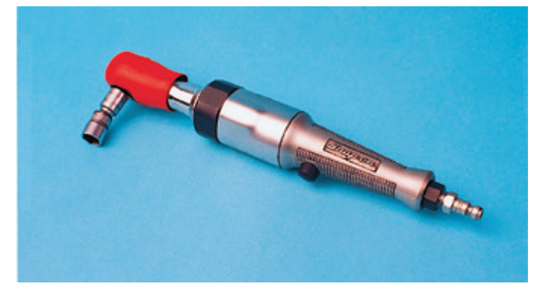
Air/Electric Ratchet
They have a special ability to work in hard-to-reach places.
Its angle drive reaches in and loosens or tightens where other hand or power wrenches just cannot work.
Air ratchets look like ordinary ratchets but have a fat handgrip.
Electric ratchets tend to be larger than air ratchets.

Slide 34
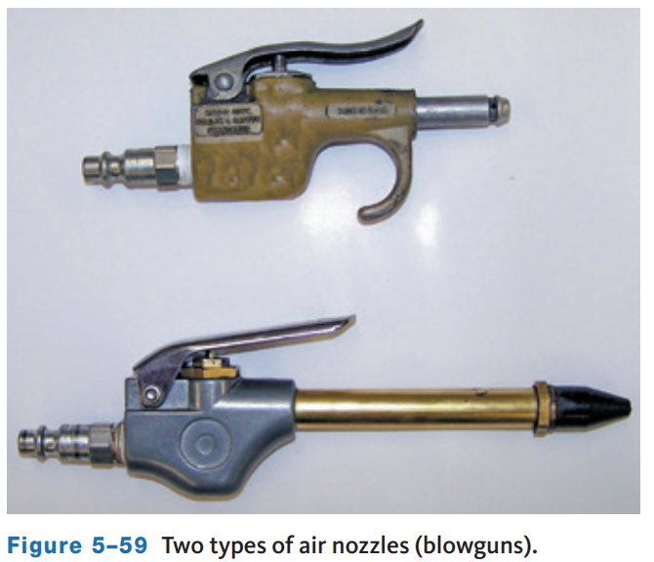
Blowgun
Blowguns are used for blowing off parts during cleaning
Never point a blowgun at yourself or anyone else
A blowgun snaps into one end of an air hose and directs airflow when a button is pressed
Always use an OSHA-approved air blowgun

Slide 35
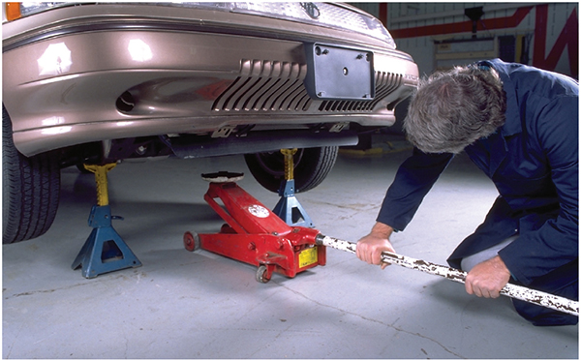
Jacks and Lifts
05.07 Describe the types and safe use of jacks and lifts.
Floor Jack
  A floor jack is a portable unit mounted on wheels in which lifting pad on the jack is placed under the chassis of the vehicle, and the jack handle is operated with a pumping action.
  This forces fluid into a hydraulic cylinder in the jack, and the cylinder extends to force the jack lift pad upward and lift the vehicle.

Slide 36
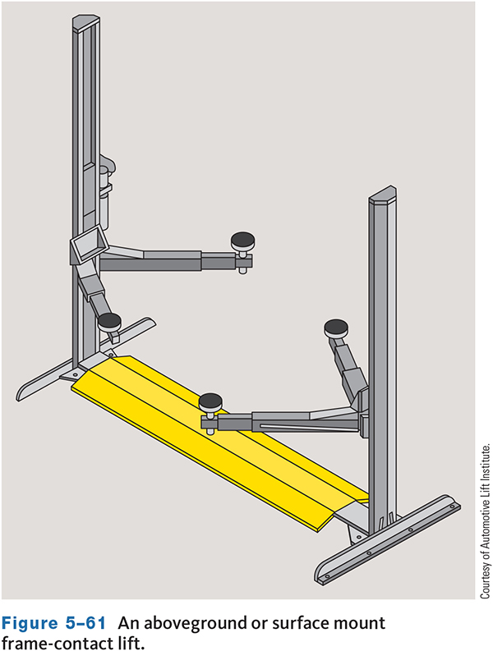
Lift
A floor lift is the safest lifting tool
  It is able to raise the vehicle high enough to allow you to walk and work under it.
  Before lifting a vehicle, make sure the lift is correctly positioned.
There are three basic types of lifts:
  Frame contact, wheel contact, and axle engaging.

Slide 37
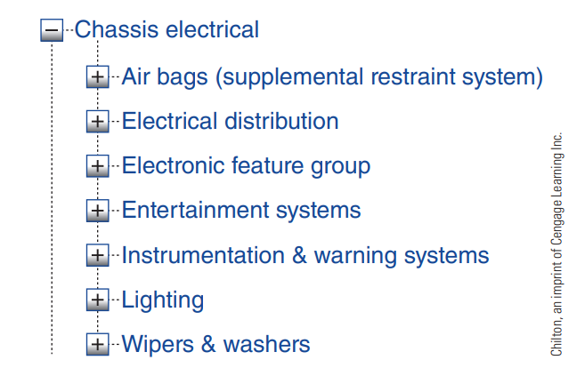
Service Information (1 of 2)
05.08 Describe the different sources of service information that are available to technicians.
The primary source for repair and specification information for any car, van, or truck is the manufacturer.
The manufacturer publishes appropriate service each year, for every vehicle built.
The information may be divided into sections such as chassis, suspension, steering, emission control, fuel systems, brakes, basic maintenance, engine, transmission, body, and so on.

Slide 38
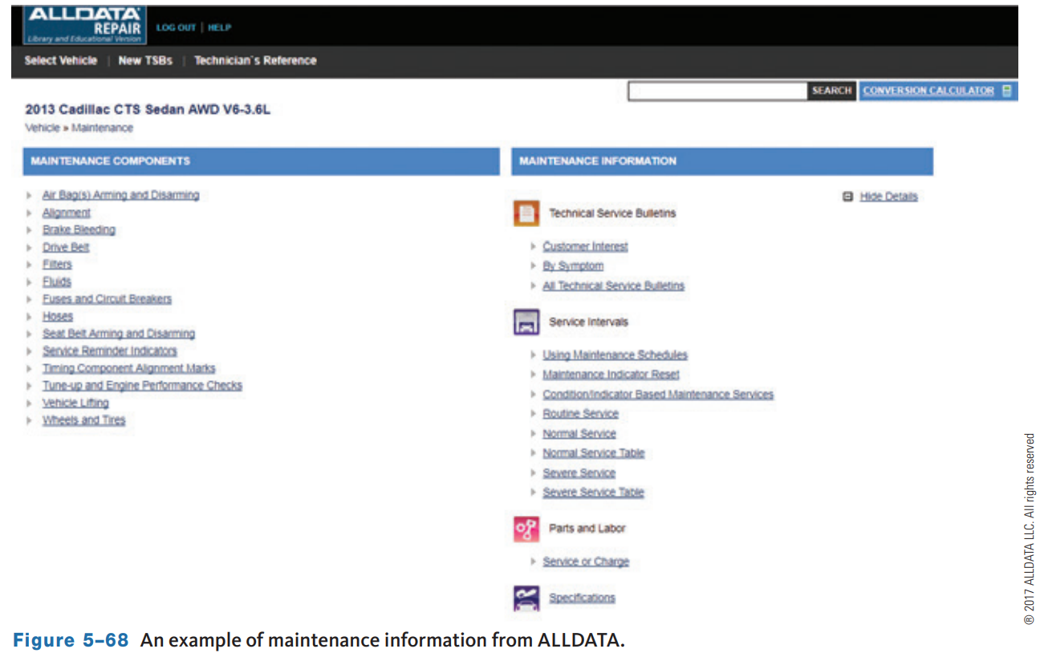
Service Information (2 of 2)
Although the information from different publishers varies in presentation and the arrangement of topics, all are easy to use after you become familiar with their organization.
Most are divided into a number of sections, each covering different aspects of the vehicle. The beginning sections commonly provide vehicle identification and basic maintenance information.

Slide 39
Other Sources of Service Information (1 of 2)
Aftermarket Suppliers’ Guides and Catalogs
Many of the larger parts manufacturers have excellent guides on the various parts they manufacture or supply and provide updated service bulletins on their products.
Lubrication Guides
  These specially designed service manuals contain information on lubrication, maintenance, capacities, and underhood service. The lubrication guide includes lube and maintenance instructions, lubrication diagrams and specifications, vehicle lift points, and preventive maintenance mileage/time intervals. The capacities listed include cooling system, air conditioning, cooling system air bleed locations, wheel and tire specifications, and wheel lug torque specifications.

Slide 40
Other Sources of Service Information (2 of 2)
Owner’s Manuals
  An owner’s manual comes with the vehicle when it is new. It contains operating instructions for the vehicle and its accessories. It also contains valuable information about checking and adding fluids, safety precautions, a complete list of capacities, and the specifications for the various fluids and lubricants for the vehicle.
Hotline Services
  Hotline services provide answers to service concerns by telephone. Manufacturers provide help by telephone for technicians in their dealerships. There are subscription services for independents to be able to get repair information by phone.

Slide 41
Knowledge Check (3 of 3)
What is the safest lifting tool?

Slide 42
Knowledge Check Answer (3 of 3)
What is the safest lifting tool?
Answer: A lift is the safest lifting tool.

Slide 43
Chapter Reflection
Please take a moment to compare your perception of the automotive industry before and after you studied this chapter. Then respond to the following questions in one or two paragraphs. Use 150–200 words in your reflection.
Do you feel you have learned more about hand tools and shop equipment than expected?
Considering all you have learned, do you feel you know all you need to regarding hand tools and shop equipment to be prepared for work and school activities?

